Slide 1
Hotel Reviews Classification Project Submitted to EXCELR Raising Excellence
Mentors :- Vinod Sir& Munmun Mam
Start date:- 12/10/2020
End date:- 30/11/2020
Team Name : G3 - The Blackholes
Alok, Ashish, Pooja, Manthan, Yogesh, Shakila

Slide 2
Business Objective
Attributes considered by travelers while choosing hotels
Positive and negative experiences shared by them
Which elements influence more in hotel selection
How these influence brand image
Predict the ratings based on reviews
What influences a customer when choosing a hotel?

Slide 3
Project Architecture / Project Flow
Business Understanding
Test data
Model Evaluation
Splitting
Cleaned data
EDA
Train data
Prepared data
tokenized
Model Building
Deployment
New data
Cleaned data
Prepared data
Predict
Feedback
Decision Making
Feedback to Client
Ratings
Notes:
Introduction
Business Objective
Data Collection
EDA / preprocessing
Feature engineering
Model Building
Model Evaluation
Feedback
Deployment
Feedback

Slide 4
Domain Understanding
Knowing the Hotel industry

Slide 5



Slide 6
Why Hotels ?
Food and beverages
Accommodation
Cleanliness and hygiene
Comfort
Safe and secured
Value for money
Overall take-away
good experience

Slide 7
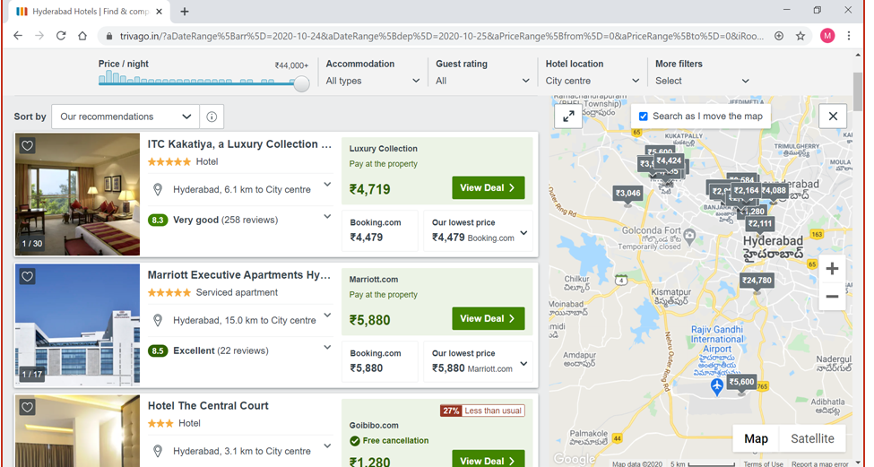
Hotel selection process

Slide 8
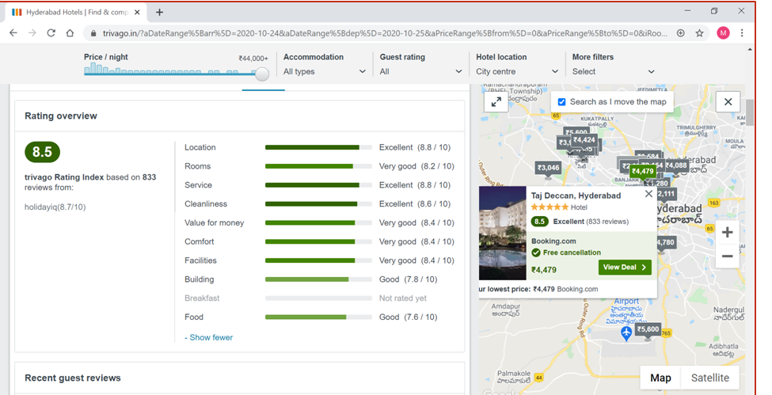
Ratings based on main parameters

Slide 9
Domain Expert Interview
Reviews are handled by General Manager
Reviews collected internally as well : feedback forms.
Safety: OSHA regulations followed strictly
Single lady guest (10%-18%) – single lady programmes
Lady employees – self protection training
Lost & found: SOP (standard operational procedures)
Hygiene: Regular fumigation and Deep cleaning
Strategy meet: Daily GM and HODs
Complaint: one-day training given compulsorily to the staff
Customized service: babies, elderly, anniversaries
Wow factors: extra care, customized service, gifts
CSR activities: free training and placement
Reviews: Tripadvisor, Trivago, FaceBook, Instagram
WARM WELCOME FOND FAREWELL

Slide 10
EXPLORATORY DATA ANALYSIS(EDA)
Exploring data to the deep !

Slide 11
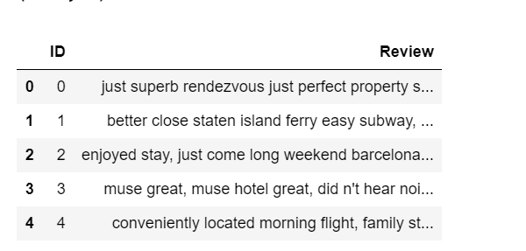
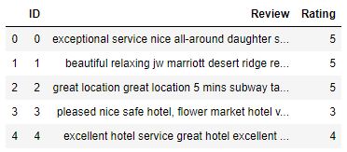
Dataset Details – Train and Test data
Features / Variable / Columns : ID , Reviews , Rating(absent in Test data)
Dimensions of Train data = 14343 rows X 3 columns
Dimensions of Test data = 6148 rows X 2 columns
No missing values
Features / Variable / Columns : ID , Reviews , Rating
Dimensions of Train data = 14343 rows X 3 columns
No missing values
No duplicate reviews

Slide 12
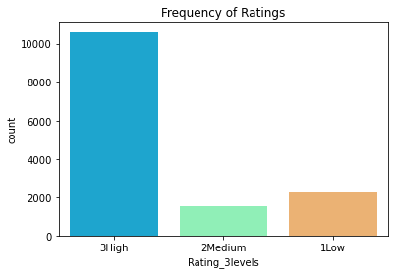
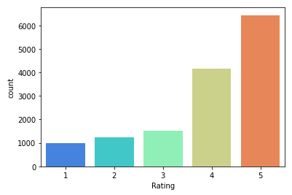
Number of reviews for each rating
Ratings 5 levels | No. of reviews
5 | 6436
4 | 4172
3 | 1510
2 | 1248
1 | 977
Ratings 3 levels | No. of reviews
3High | 10608
2Medium | 2225
1Low | 1510

Slide 13
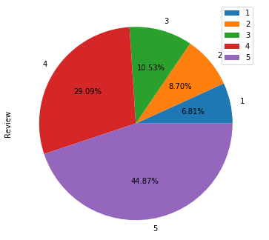
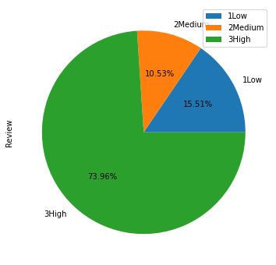
Proportion of Ratings

Slide 14
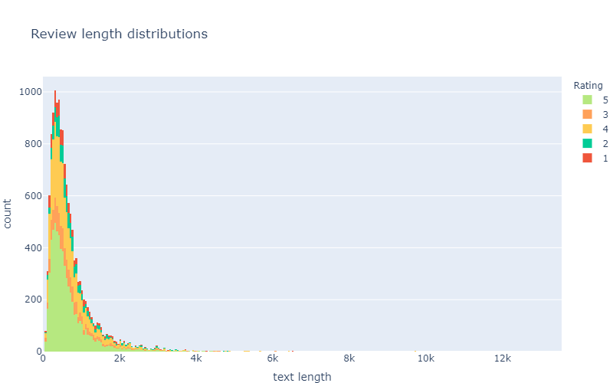
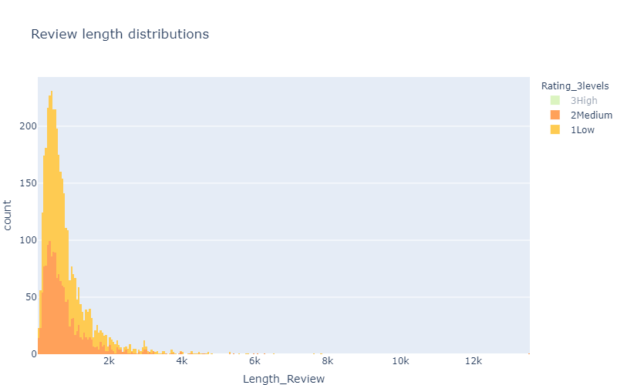
Review length for 5-level and 3-level ratings

Slide 15
From previous graph it can be seen that graph is very close signifying that average difference of text length between all the rating is very small.
The average size of a review is ~700 characters.
There are some really big reviews in this dataset, mostly about 3+ ratings

Slide 16
TEXT PRE-PROCESSING
Text pre-processing is the most important step before further exploring a text data. It removes unwanted and unnecessary texts.
Following text pre-processing steps were included:
Converting to lower case
replace n't and 'nt with not (replacing contractions)
Removing stop words by creating some new custom stop words.
Remove punctuations
Remove tags
Remove special characters and digits
Lemmatization – reducing words to their root words

Slide 17
Creating a list of customized stopwords
First list of customed stopwords
new_words = ['n', "th","hotel“, 'rooms', 'restaurant‘]
Second list of customed stopwords
new_words = ['n',"th","hotel",'hotels','room','rooms','restaurant','restaurants','e','ca','nd','wo','el','etc‘]
All these words appeared at least 100 times in the corpus
Removed plurals – since were not lemmatized and were not removed in the first instance
Expanding of contractions – n’t and ‘nt were replaced by ‘not’
Since word ‘not’ is important for analysis , it was removed from list of stopwords

Slide 18
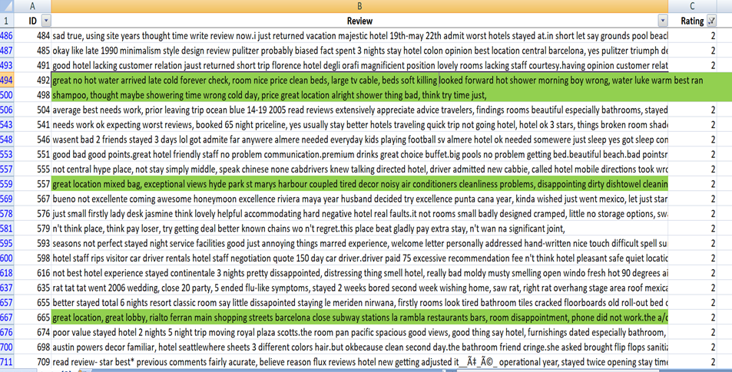
Checking words with full reviews To know the context where and when used Here, great location used in Rating-2, even though location is great, services are not good

Slide 19
Finding frequency of words
Created a clean_review_list and split it into words
13,68,889 words are present (includes repetition of words as well)
Found unique words
37,558
Words appeared only once in our dataset, hence not included
18606
Of these 37,558 unique words.
There are 5779 words with frequency >=15
There are 2913 words with frequency >=50
There are 1860 (5%) words with frequency >=100
After trying various number of words, it was found that 3000 words were better for model building (max_features=3000)

Slide 20
COMBINING THE RATINGS
The dataset seems to be highly imbalanced, this might turn out to be a problem in model building, we will have to take steps which can make the model balanced
Or we can try to form 3 classes:
Since after predicting for 5 –level ratings , the ratings 2,3,4 , were showing low accuracy and F1 macro ( F1, recall, etc) scores, so combined into 3 level ratings
Old Ratings | New Ratings
1 and 2 | 1Low
3 | 2Medium
4 and 5 | 3High

Slide 21
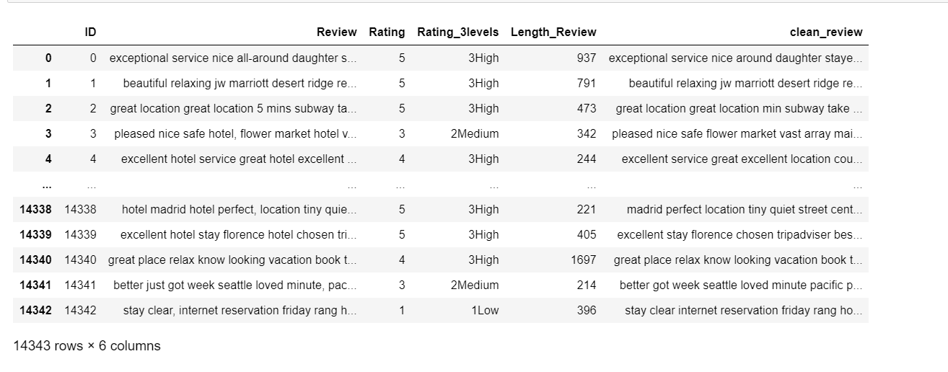
New 3 level ratings and Cleaned text used in further analysis

Slide 22
N-GRAM ANALYSIS
Exploring Uni-grams, Bi-grams and Tri-grams

Slide 23
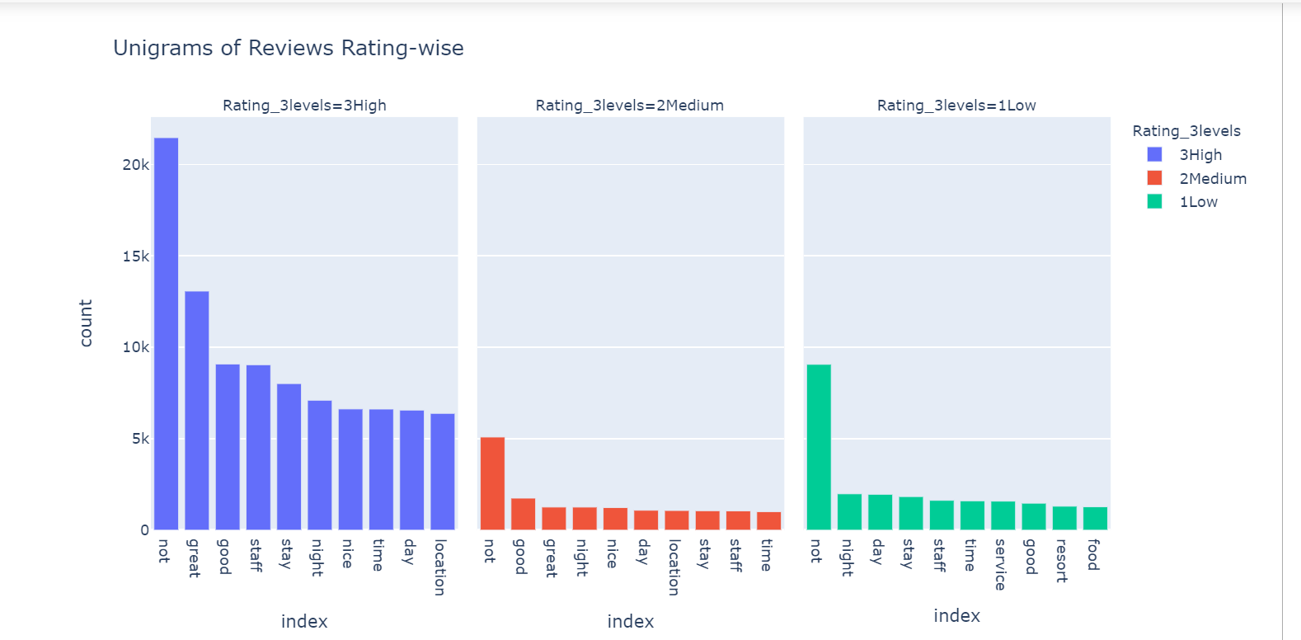
Unigrams

Slide 24
BI-GRAMS
A bigram is a sequence of two adjacent elements from a string of tokens, which are typically letters, syllables, or words.
A bigram is an n-gram for n=2. The frequency distribution of every bigram in a string is commonly used for simple statistical analysis of text in many applications, including in computational linguistics, cryptography, speech recognition, and so on.
In next slide it can be seen that rating-1 reviews contains mostly ‘not’ like (not worth, not recommended, not good )pairs that can be describing bad characteristics about hotel.
Rating-3 reviews have good pairs of words about hotel characteristics, like(highly recommended, friendly helpful, place stay).
It can be seen that Rating-2 reviews have both positive and negative pairs, like(not good, not great, walking distance, minute walk, staff friendly).

Slide 25
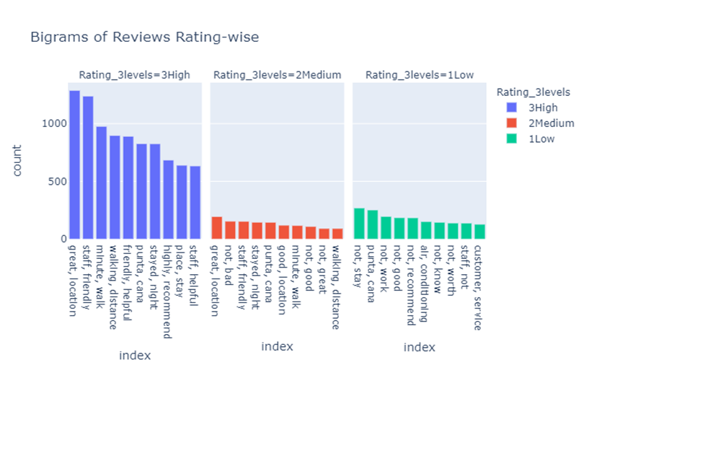

Slide 26
TRI-GRAMS
Trigrams are a special case of the n-gram, where n is 3. They are often used in natural language processing for performing statistical analysis of texts and in cryptography for control and use of ciphers and codes.
Analyzing tri-grams we can collect more details about reviews on different ratings.
In Rating-2 reviews pairs like(not speak English, food not good, not worth money) clearly says the problems associated with hotels.
In Rating-3 reviews, pairs like(easy walking distance, great location, good value money)
Rating-2 reviews contains both positive and negative words
Some pairs can be seen both in Rating-3 and Rating-2 reviews like(free internet access, flat screen tv, staff friendly helpful)
Some pairs can be seen in all types of reviews like (king size bed, old san juan)

Slide 27
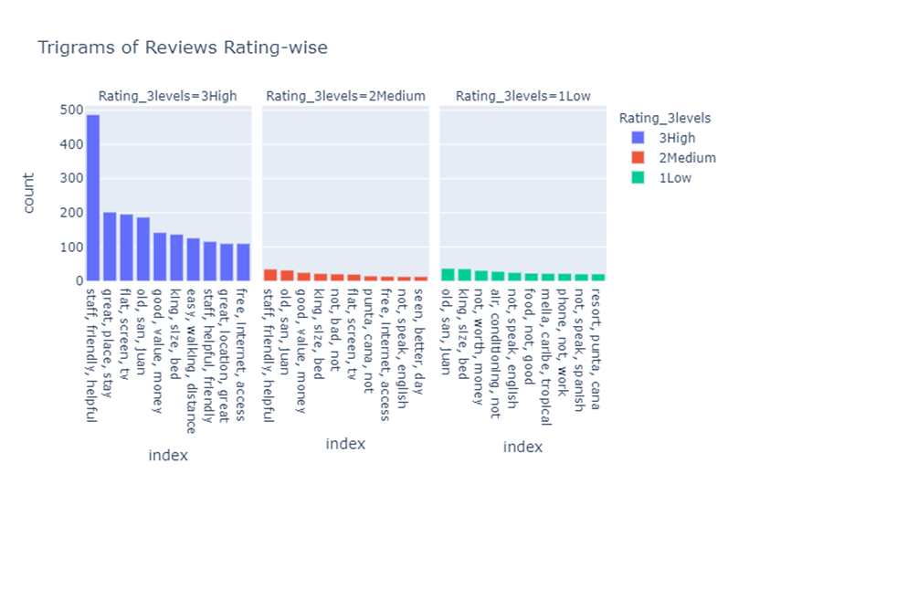

Slide 28
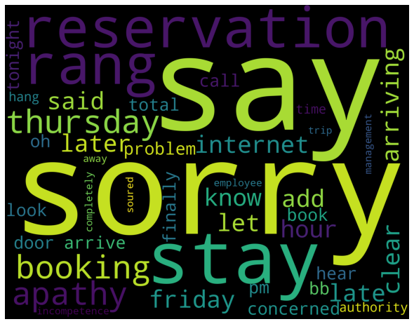
Word cloud – All words
Includes all words – highest frequency words have larger size
Words used often are sorry, reservation, etc

Slide 29
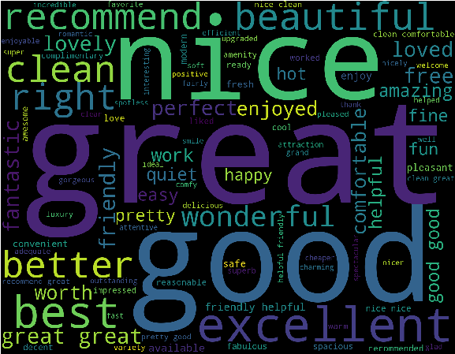
POSITIVE WORDCLOUD
It represents the positive words present in the overall dataset.
Words like good , great, nice are most frequent words
Words like beautiful , recommend , excellent, better shows some of the good characteristics of hotels.

Slide 30
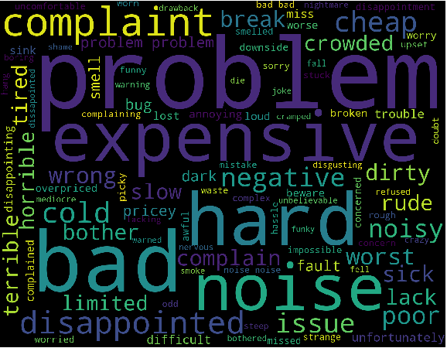
NEGATIVE WORD CLOUD
It represents the negative words present in the overall dataset.
Words like problem, bad , hard, noise are most frequently used words.
Words like complaint , disappointed , terrible , horrible depicts the bad characteristics of the hotels.

Slide 31
SENTIMENT ANALYSIS
Knowing the sentiments !!

Slide 32
Calculated sentiments using Text Blob and Vader
Polarity (ranges between -1 and +1)
Subjectivity (ranges between 0 and 1)
Polarity
+1 means positive statement
-1 means negative statement
Subjectivity
0 means objective
1 means subjective

Slide 33
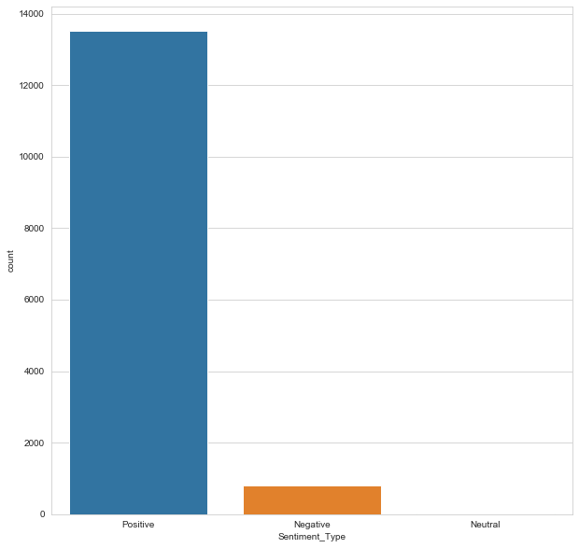
Most are positive sentiments
Very few negative
Very very less are neutral

Slide 34
VADER
Tells us how much positive or negative a sentiment is
Use Compound score - sum of all the lexicon ratings which have been normalized between -1 (most extreme negative) & +1 (most extreme positive).
positive sentiment : (compound score >= 0.05)
neutral sentiment : (compound score > -0.05) and (compound score < 0.05)
negative sentiment : (compound score <= -0.05)

Slide 35
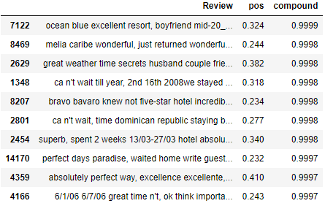
Most Positive Sentiment reviews based on Compound scores

Slide 36
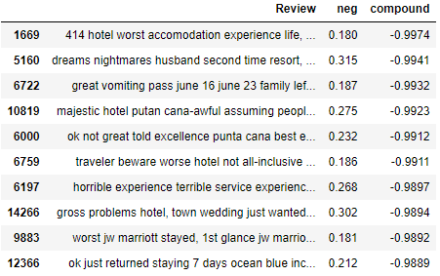
Most Negative Sentiment Reviews based on Compound Scores

Slide 37
NAMED ENTITY RECOGNITION(NER)
Entity Extraction !!

Slide 38
Named Entity Recognition/Entity Extraction
In any text document, there are particular terms that represent specific entities that are more informative and have a unique context.
These entities are known as named entities , which more specifically refer to terms that represent real-world objects like people, places, organizations, and so on, which are often denoted by proper names.
A naive approach could be to find these by looking at the noun phrases in text documents. Named entity recognition (NER) , also known as entity chunking/extraction.
It is a popular technique used in information extraction to identify and segment the named entities and classify or categorize them under various predefined classes.

Slide 39
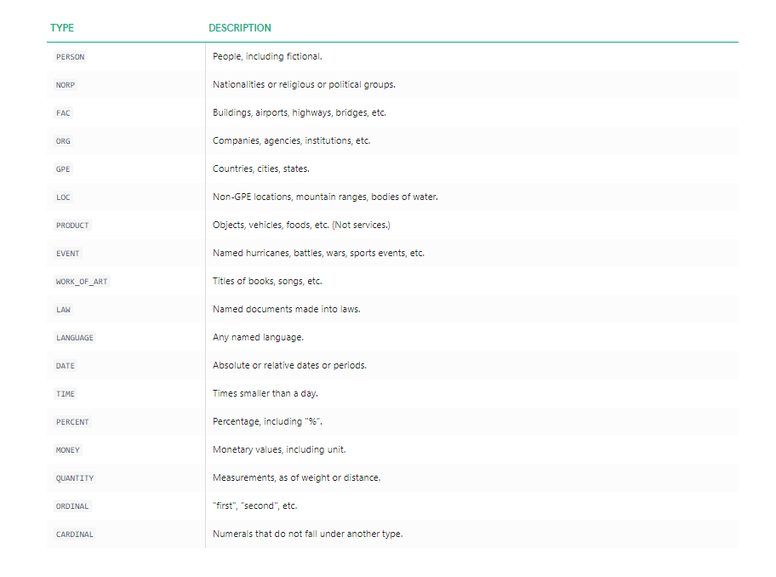

Slide 40
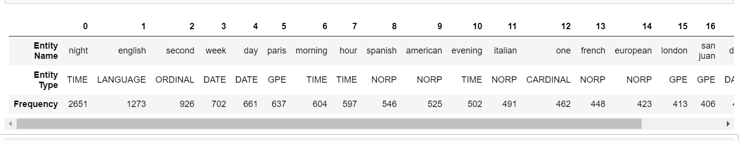
Named Entity Recognition/Entity Extraction
Top named Entities:
Here, we can see that it has correctly identified Spanish, Italian, American as nationalities. We can also see that night is mostly used.
Top named Entity types : Here we can see country/cities/states, persons, organizations are the most mentioned entities.

Slide 41
TOPIC MODELLING
Topic Modelling using LDA !!

Slide 42
What is topic modeling?
Topic Modeling is a technique to extract the hidden topics from large volumes of text.
At the moment, the most popular algorithm is LDA (Latent Dirichlet Allocation), but there are a lot of other approaches for different purposes.
For example, topic modeling for short text is a very difficult task with special algorithms.
Also, topic modeling is not a simple process, because we need clear text data at the start.
Well, here we have used Classical approach : LDA model.

Slide 43
Topic Modelling using LDA – 4 Topics
Imported libraries
Added bigrams and trigrams to docs (only ones that appear 10 times or more).
Created a dictionary representation of the documents
Created Term-document matrix
Set training parameters – num_topics = 4
Built different models using 2 to 10 and 100 topics
when used 4 topics, they could be clearly distinguished and named

Slide 44
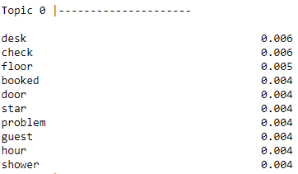
FIRST TOPIC
Topic 0 = "Worst Hotels",
It includes words like (desk,check,star,booked,problem),that make us think that this topic can be related with lower rating of hotels, and seems that those problems are related with reservation problems,reception desk problems,basically the worst hotels.

Slide 45
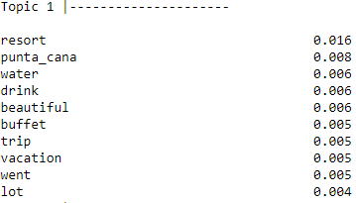
SECOND TOPIC
Topic 1 = "Resort Hotels",
words like(resort,punta_cana,vacation,trip) clearly shows that it's related to Resort hotels.

Slide 46
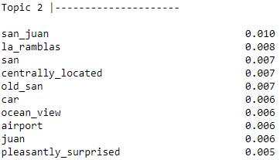
THIRD TOPIC
Topic_3 = ‘Beach Hotels’
Words like(san_juan, la_ramblas, ocean_views), says that these types of hotels are located near the sea beaches.

Slide 47
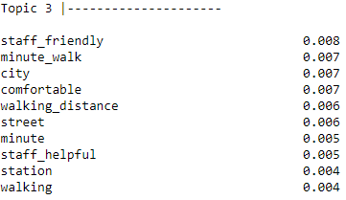
FOURTH TOPIC
Topic 2 = "Top/Best/Comfortable Hotels",
it includes words like(minute_walk,walking_distance,staff_helpful,comfortable).This means it's related with City Hotels, Close to station/airport or simply located in a major location.

Slide 48
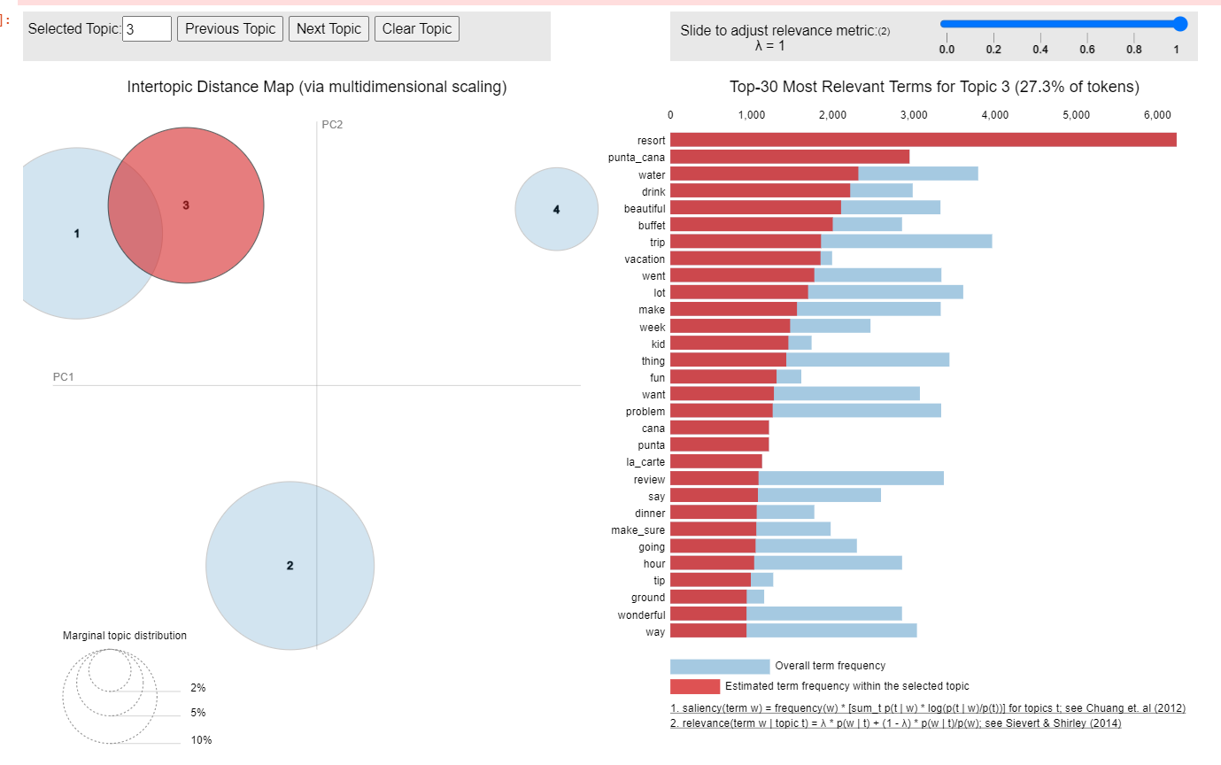
The 4 Topics Showing most common words of Topic-3

Slide 49
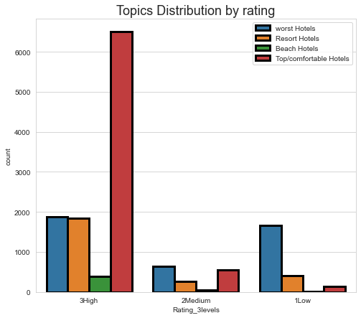
Topic Distribution for Ratings
Highest count of keywords of top/comfortable hotels is in High rating
All 4 topics are in very low frequency in Medium rating
Proportion of worst hotels topic as compared to other hotel topics is high in Low rating .

Slide 50
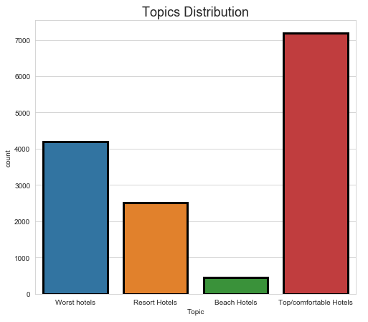
Here numbers of keywords related to top/comfortable hotels are high, followed by worst hotels, then by resort hotels, least is Beach hotels

Slide 51
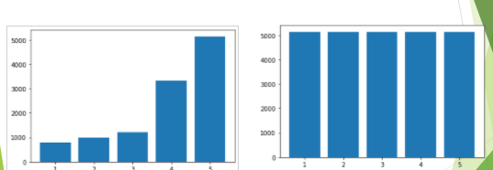
Balancing the data - SMOTE
SMOTE is an oversampling technique
Since our data is imbalanced , used it on train data to balance per level records
Then ran various models , for 5-level ratings – but got poor results
Log-reg, MNB, SVC(rbf, linear), RF (gini criterion)

Slide 52
MODEL BUILDING

Slide 53
Word Vectorization
Feature extraction using Bag of words
Disregard Grammar, disregard Order of occurrence of words, only keeping multiplicity
Measures used are:
Term frequency – binary
Whether word is present or not (1 or 0)
Term frequency (TF)
How frequently a term occurs in a document
Term frequency – Inverse Document Frequency (TF-IDF)
How important a term is
Highlight words that are more frequent in a document but not across documents
we have a large vocabulary on which we can observe the behaviour of words by using IDF weightings

Slide 54
Various model used, changed attributes, parameters
Vectors – tf (binary) , Tf, tf-idf
Number of terms – 280 , 3000 terms , all terms (about 37000)
Very less change in overall prediction scores
Multinomial logistic regression
changed solvers - Newton-cg, lbfgs, saga,sag
class_weight
SVM –kernels (rbf, linear)
KNN – neighbours (5,11,21)
SVM --- SVC and LinearSVC
Naïve Bayes --- Gaussian NB and Multinomial NB
Decision Trees
Random Forest
Neural Networks --- NN and Keras

Slide 55
Advanced Models Built
Topic modeling
Sentiment analysis – Text blob and Vader
Named Entity Recognition (NER)
Other Techniques used :
Balancing technique - SMOTE
Length of reviews, length of clean reviews
Rating levels used :
Models built using 5-level and 3-level ratings

Slide 56
Accuracy Measures
Number of Features classified Correctly
Accuracy= ---------------------------------------------------------
Number of Features
Number of Features classified Incorrectly
Misclassification Rate = ----------------------------------------------------------- = 1 - Accuracy
Number of Features
Correctly predicted positive observations
Precision = ----------------------------------------------------------------
Total predicted positive observations
Correctly predicted positive observations
Recall = ---------------------------------------------------------------------
All the positive observations
2 * Recall * Precision
F1 Score = ------------------------------------- = weighted average of Precision and Recall
(Recall + Precision )

Slide 57
Multinomial Logistic Regression – 5 level rating
Model |  |  |  |  | rows, columns | train - test split | Test accuracy score | Test recall (%) | Train accuracy score | Train recall (%)
Log reg - Multinomial | random_state=123, solver='newton-cg' | tf - binary | min_df=10 |  | 14343, 6885 | 70 - 30 | 0.554 | 57,34,31,44,72 | 0.9722 | 100, 100, 98, 94, 98
"" | random_state=123, solver='newton-cg' | tf | min_df=10 |  | 14343, 6885 | 80 - 20 | 0.56814 | 65,36,30,46,73
"" | solver='saga' | tf | no convergence
"" | solver='sag' | tf | no convergence
"" | solver='lbfgs' | tf | no convergence
"" | random_state=123, solver='newton-cg' | tf | min_df=10 | 14343, 6885 |  | 10 fold CV |  |  | 0.57216
"" | random_state=123, solver='newton-cg' | tfidf | "" | "" |  | 80 - 20 | 0.61275 | 60,38,20,49,84 | 0.77 | 82,67,48,68,91
"" | "" | "" | "" | "" |  | 75 - 25 | 0.60987 | 58,37,21,49,84
"" | "" | "" | "" | "" |  | 70- 30 | 0.6091 | 59,34,19,49,84
"" | "" | "" | "" , mx_feat=4000 | 14343, 4000 |  | 80 - 20 | 0.6134 | 61,38,20,49,84
"" | "" |  | "" , mx_feat=5000 | 14343, 5000 |  | "" | 0.61 | 59,38,21,49,84 | 0.78 | 86,70,49,69,91

Slide 58
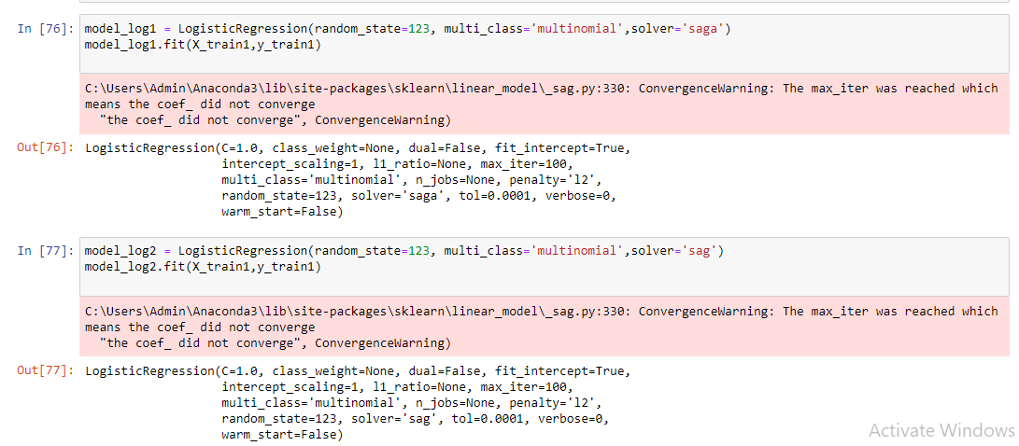
Multinomial log-reg solvers – did not converge

Slide 59
K – Nearest Neighbor Classifier – 5 level rating
Model |  |  |  |  |  | rows, columns | train - test split | Test accuracy score | Test recall (%) | Train accuracy score
KNN | n_neighbors=5 | "" | min_df=10 | 14343, 6885 |  | 70- 30 |  | 0.4882 | 39,17,16,42,69
KNN | n_neighbors=11 | "" | "" | "" |  | "" |  | 0.5103 | 39,13,12,41,76 | 0.5961
KNN | n_neighbors=21 | "" | "" | "" |  | "" |  | 0.5166 | 32,09,07,39,81
Naïve Bayes – 5 level rating
 |  | Test accuracy score | Test recall (%) | Train accuracy score | Train recall (%)
Gaussian Naive Bayes | Tfidf, min_df=10 | 0.2888 | 27,22,23,25,34 | 0.54 | 100,81,77,44,43
Multinomial NB | “” | 0.5152 | 16,05,00,26,94 | 0.59 | 34,14,01,40,97

Slide 60
Decision Trees and Random Forest – 5 level rating
Model |  |  |  | rows, columns | train - test split | Test accuracy score | Test recall (%) | Train accuracy score | Train recall (%)
Decision Tree | criterion='gini', random_state=111 | tfidf | min_df=10 | 14343, 6885 | 80 - 20 | 0.451 | 47,23,21,36,61 | 1 | 100, 100, 100, 100, 100
“” | criterion='entropy',max_features=5000 | "" | "" | "" | "" | 0.4513 | 46,20,22,36,61 | 1 | 100, 100, 100, 100, 100
“” | criterion='entropy',max_features=3000,rs=111 | "" | "" | "" | "" | 0.4395 | 48,19,19,34,60 | 1 | 100, 100, 100, 100, 100
“” |  |  | "" , mx_feat=4000 | "" | "" | 0.45381 | 45,20,22,37,61 | 1 | 100, 100, 100, 100, 100
Random Forest | n_estimators=200, entropy, max_depth=None | "" | min_df=10 | "" | 80 - 20 | 0.5441 | 58,04,01,22,97 | 1 | 100, 100, 100, 100, 100
“” | n_estimators=1000,max_depth=30, minSmplLf=5, entropy | "" | "" | "" | "" | 0.4956 | 35,01,00,08,100 | 0.65 | 58,30,08,44,100

Slide 61
Neural Networks – 5 level rating
Support Vector Machine – 5 level rating
Model |  |  |  | rows, columns | train - test split | Test accuracy score | Test recall (%) | Train accuracy score | Train recall (%)
SVM | SVC(kernel=rbf) | tfidf | "" | 14343, 6885 | 70: 30 | 0.6165 | 53,43,14,52,85
LinearSVC |  | "" | "" | "" | "" | 0.5103 | 39,13,12,41,76 | 0.92 | 100, 97,88,84,95
Model |  |  |  | rows, columns | train - test split |  | Test accuracy score |  |  | Train accuracy score
Neural Networks | epochs=100, batch_size=100, HL=1(8) | Tfidf | Min_df=10 | 14343, 6885 | 80 : 20 | 0.5225 |  |  |  | 0.9971
"" | epochs=100, batch_size=100, HL=3(10,10,10) |  |  |  |  | 0.5051 |  |  |  | 0.9189
NN keras classifier | kfold=5 |  |  |  |  | 0.5947 (sd 0.78%)
 | ep=20, bt=100, rmsprop |  |  |  |  |  |  |  |  | 0.45
 | full data | test accuracy decr and test loss incr

Slide 62
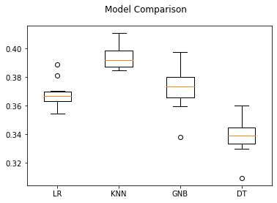
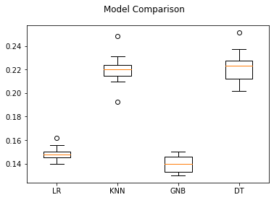
Models on Cleaned reviews
Cross validation (kfold=10) run on all models
F1 macro score used for scoring
Different models built using either polarity or subjectivity
Polarity
Subjectivity

Slide 63
Model comparison – 3 level Ratings
Models run using tfidf, 80:20 split and 3000 features
We chose the Multinomial log reg model for final analysis
This model was not over-fitting and also predictions of medium rating were better
Models | Train acc | Train F1 macro | Test acc | Test F1 macro | F1 score test data 1Low 2Medium 3High
SVM - rbf | 97 | 94 | 85 | 62 | 76 | 17 | 92
MNB | 83 | 55 | 82 | 53 | 69 | 00 | 90
KNN (neigbr=11) | 82 | 56 | 80 | 51 | 59 | 06 | 89
Multinomial log reg | 90 | 77 | 86 | 66 | 76 | 29 | 93
Decision Tree | 100 | 100 | 74 | 53 | 53 | 22 | 85
Random Forest | 100 | 100 | 82 oob_score=82 | 52 | 66 | 00 | 89
Multinomial log reg Kfold=10 |  |  |  | 67

Slide 64
Multinomial Logistic Regression
Final model chosen : used tfidf vectorizer with 3000 features

Slide 65
Here we have used TF-IDF vectors using maximum features of 3000.
Algorithm details :
Multinomial Logistic Regression
Random state = 123
Solver = ‘newton-cg’, other solvers did not converge
Data partition details :
80:20 partition ratio preferred (found this ratio gave better results)
stratify = yes (this maintains the proportion of classes of original data even in both the split data)

Slide 66
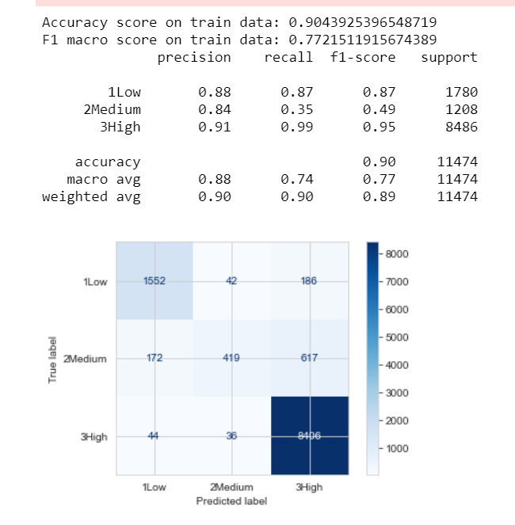
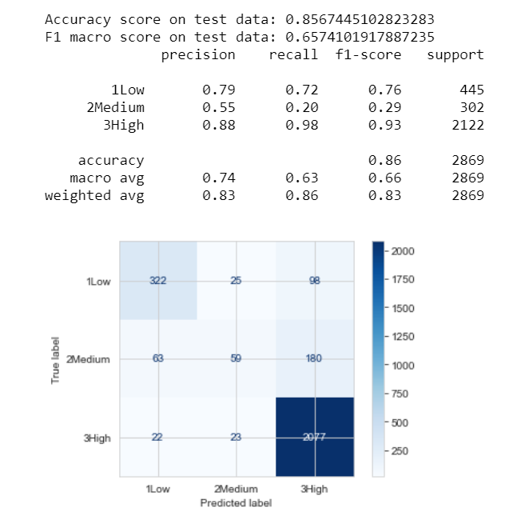
Train dataset
Train accuracy is 90%
F1-macro score is 77%
Validation dataset
Test accuracy is 86%
F1-macro score is 66%
Rating-2 predicted score is low

Slide 67
Test Dataset & pre-processing
The test dataset has Reviews but we need to predict ratings
The top terms in test data are similar to that of train data terms as seen in next table
Text pre-processing
The dataset was pre-processed, to get clean reviews
Transforming using tfidf vectorizer
The tfidf vectorizer was fit on train data and then it was transformed
For test data, we only transformed using tfidf vectorizer

Slide 68
Top frequent words
Train data
Test data
 | Word | Frequency | percent Freq_all | percent Freq_unique
0 | not | 35612 | 2.60 | 94.82
1 | great | 15197 | 1.11 | 40.46
2 | good | 12287 | 0.90 | 32.71
3 | staff | 11700 | 0.85 | 31.15
4 | stay | 10885 | 0.80 | 28.98
5 | night | 10326 | 0.75 | 27.49
6 | day | 9586 | 0.70 | 25.52
7 | time | 9208 | 0.67 | 24.52
8 | nice | 8837 | 0.65 | 23.53
9 | location | 8139 | 0.59 | 21.67
 | Word | Frequency | Percent Freq all | Percent Freq unique
0 | not | 15164 | 2.65 | 63.46
1 | great | 6288 | 1.10 | 26.31
2 | good | 5204 | 0.91 | 21.78
3 | staff | 5006 | 0.87 | 20.95
4 | stay | 4716 | 0.82 | 19.74
5 | night | 4251 | 0.74 | 17.79
6 | day | 3898 | 0.68 | 16.31
7 | nice | 3810 | 0.67 | 15.94
8 | time | 3773 | 0.66 | 15.79
9 | location | 3421 | 0.60 | 14.32

Slide 69
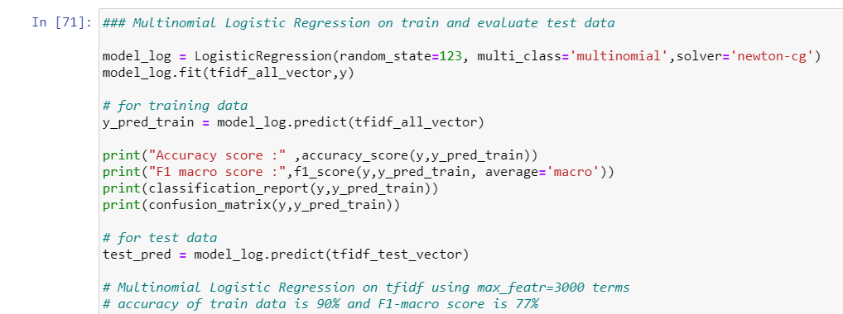
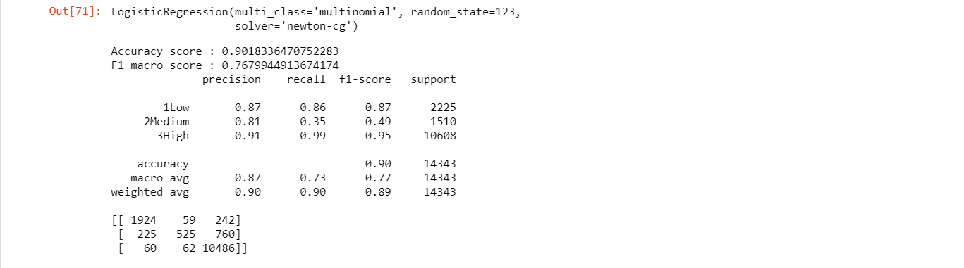
Tranforming test data & making predictions

Slide 70
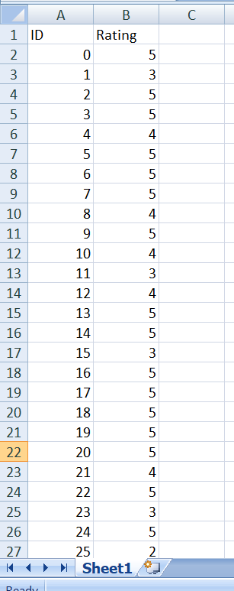
Kaggle Submission – 5-level ratings
After training the model using train data, we predicted for test data
The predictions were uploaded in kaggle. We used various models and different attributes
Multinomial Logistic regression, SVM (kernel = rbf),
Tfidf , word2vec embeddings, sentiments,
LSTM, LGBM
Various number of features (280 , 3000 , 5000 terms)
The top entries of one of the submissions made in kaggle is shown here.

Slide 71
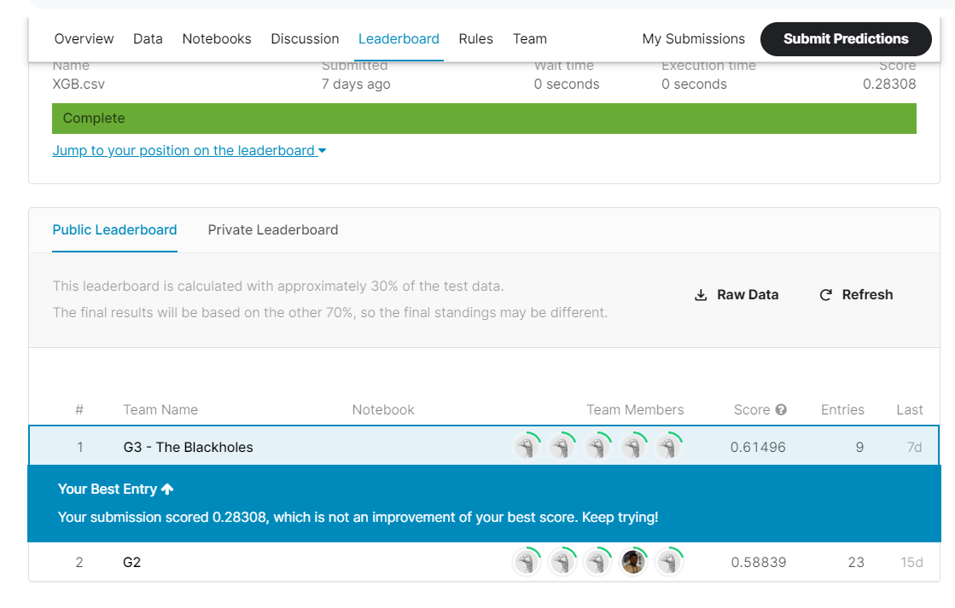
Kaggle F1 macro score
In kaggle, F1 macro scores are given
Only results of public leaderboard are made known. This is for only 30% of test data.
Private leaderboard scores are revealed at the end of the competition.
Multinomial logistic regression model using tfidf, review length and sentiments gave the best result
The best score of our team is 61.496 %
which is the highest among all teams

Slide 72
Deployment
Deploying from backend to frontend

Slide 73

Deployment Flow
FRONT
END
User Interface component
Enter Review Get Predicted Ratings
http API service
BACK
END
Model Training
Model.pkl
Model Prediction

Slide 74
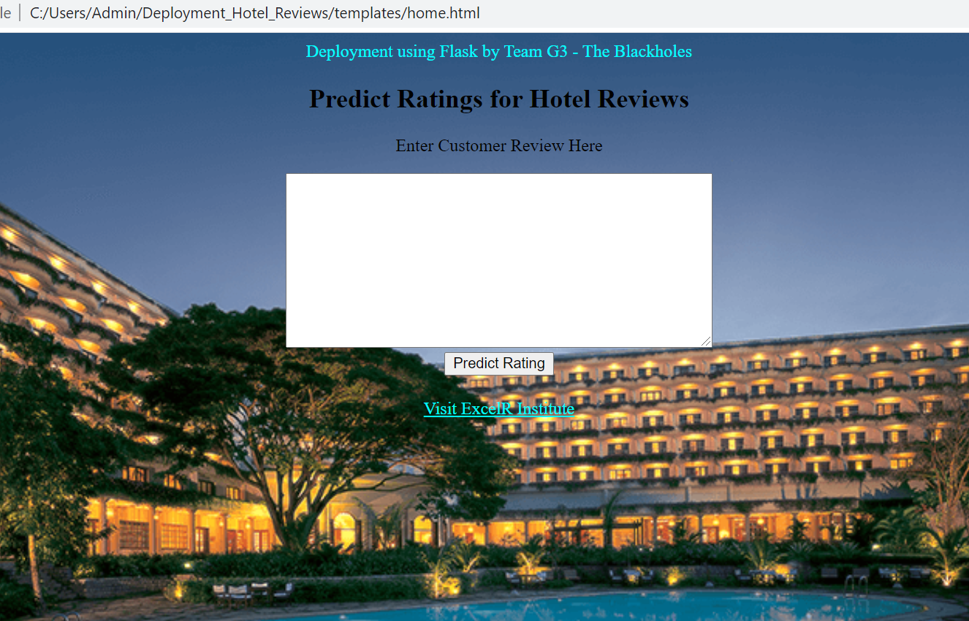
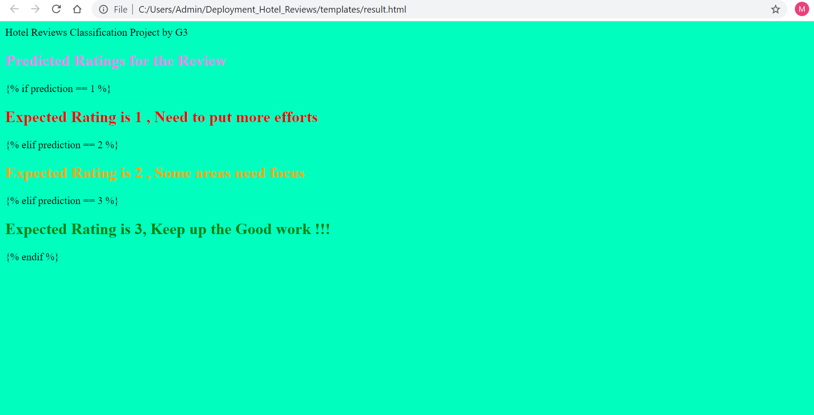
Home page
Result page

Slide 75
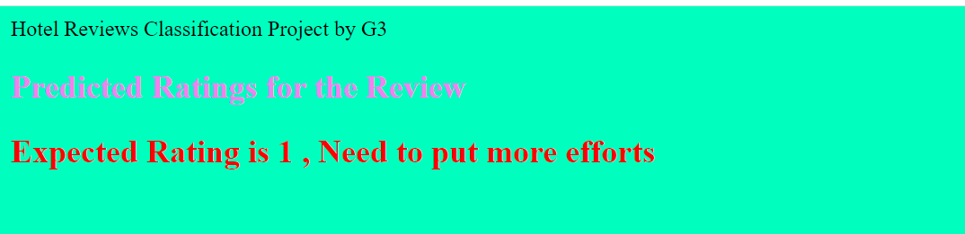
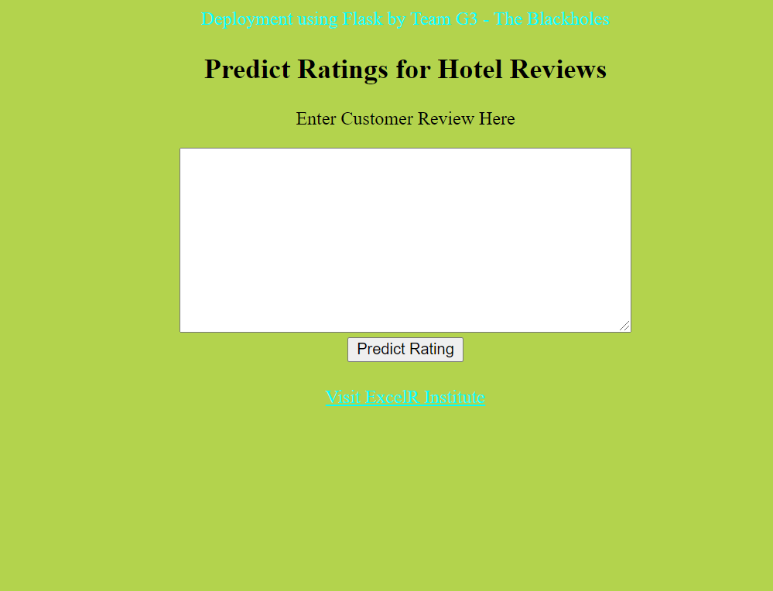
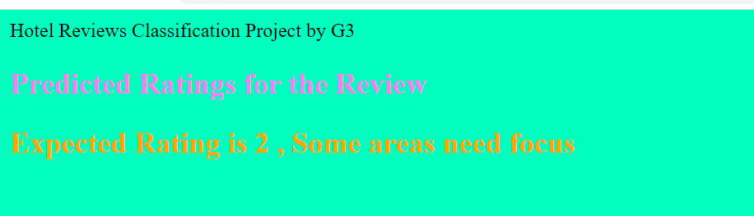
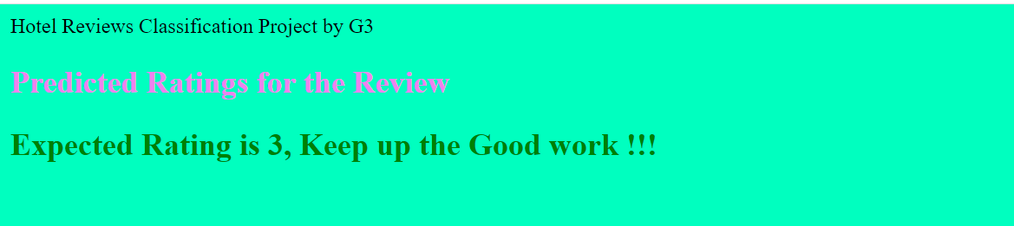
Outputs for 3 Ratings
When run on Anaconda prompt
The output Rating

Slide 76
Most times you need more than 5 star service !!!
Successful hotels may have a high degree of efficiency in guest satisfaction but there is always a next level.
Hotels are differentiated from competition
Hotels can extract reviews from social websites like facebook and predict the ratings based on our model
This will help them to easily segreagate a Rating-3 from Rating-1 and so on.
This will be helpful in taking immediate action especially when predicted ratings are very low
The model should be re-built again after say 5 to 6 months, to capture the new changes

Slide 77
Challenges
The data is regarding the Hotel industry, our team has no prior experience of this industry
We browsed the hotel websites, internet, spoke with domain expert to get domain understanding
The data is textual data. Hence converted text to word vectors
Creating a new-list of stopwords that were specific to dataset like hotel, restaurant, room
Many words like ‘aaa’ , ‘abc’ appeared with moderate frequency . Hence they were checked with original reviews . But were found genuine like former was aaa- rating and later was abc-store. Other words which were meaningless were removed
choosing the model
Ran innumerable models by changing various attributes and parameters
Advanced models were more subjective and hence gave low result scores
But the basic multinomial logistic gave better results, hence it was chosen
Though the initial rating level was 5, it gave poor results especially for ratings 2,3,4. Hence combined the ratings to 3 levels. This performed better

Slide 78
Challenges contd…
The dataset had about 14000 reviews, which is small considering that we have to do text classification. Also the data is imbalanced
Used 10 fold cross validation technique to see model performance
F1 scores were considered since they are weighted average of precision and recall
F1 macro scores were considered along with accuracy scores
F1 scores were considered along with recall and precision scores
Deployment using Flask was very new and hence challenging
First understood the flask deployment process and then worked on it
Time limitation
If more time was given, we could have tried running the models with more attribute combination
This is a classification problem
We ran various classification algorithms to find the best model

Slide 79
THANK YOU

